Slide 1

REGEX MATCHING WEB APP DEVELOPMENT

Slide 2
About me
I am Sai Sujitha.
M.Sc. Biotechnology
As Data science is used in many Industries even in my stream of education so I choose data science.
LinkedIn - https://www.linkedin.com/in/sujitha-iragavarapu-840a9a78/
Github - https://github.com/Suji1612
Medium - https://medium.com/@sujisree9

Slide 3
Objective Of The Project:
Creating a web application that allows users to input a test string and a regular expression (regex) and displays all the matches found.

Slide 4
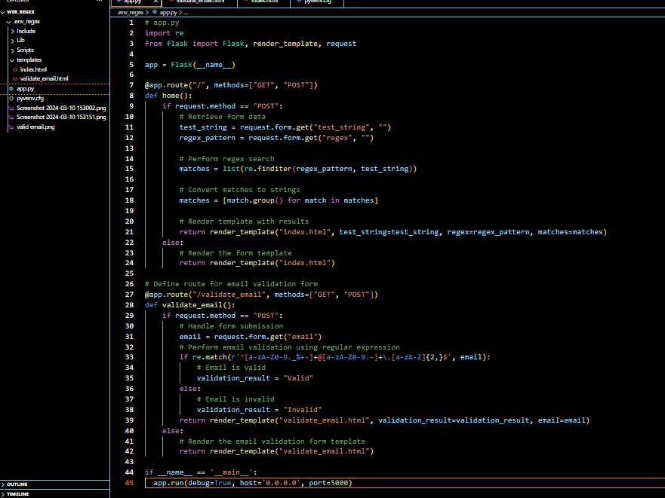
Creating a python file and flask app instance

Slide 5
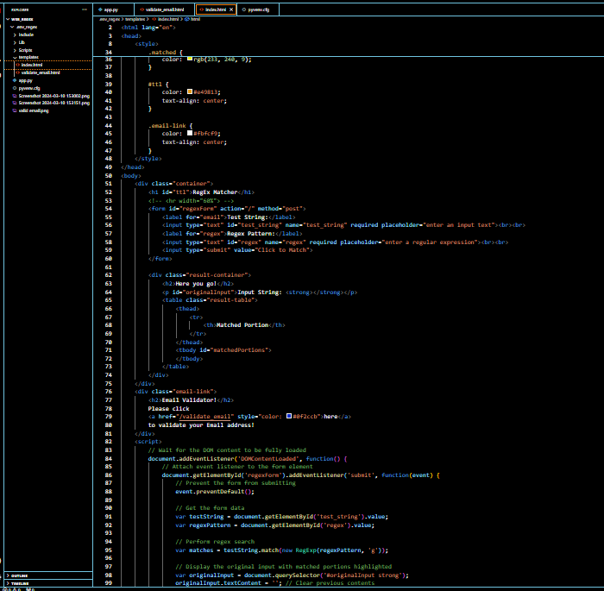
HTML File for String and Regex Pattern:

Slide 6
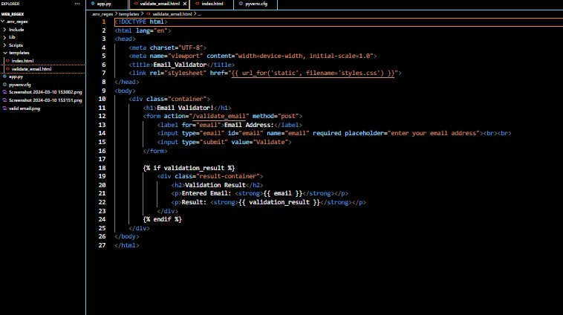
Create html for Email Validator :
Getty Images

Slide 7
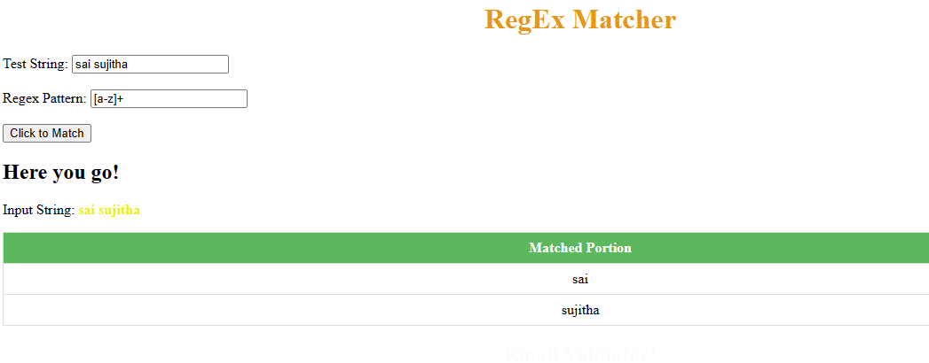
Output for Test String and Regex:

Slide 8
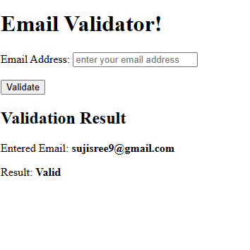
Output for Email Validator:

Slide 9

THANK YOU

